Slide 1

Internship Project
Air Quality Index Prediction Model
with Python

Slide 2

Student Name : Chetan Kachu Lande
Student ID : STU657b0e09576c41702563337
College Name : DR. D. Y. PATIL INSTITUTE OF TECHNOLOGY, Pimpri Pune

Slide 3
CAPSTONE PROJECT SHOWCASE
Project Title
Air Quality Forecast: Machine Learning Model
Abstract | Problem Statement | Project Overview | Proposed Solution | Technology Used | Modelling & Results | Conclusion | Q&A

Slide 4

Abstract
Air Quality Prediction Using Machine Learning Models
Global communities face significant environmental and health issues in the form of air pollution. This research utilized machine learning techniques to forecast the Air Quality Index (AQI) using measurements of various pollutants, including PM2.5, PM10, and other air quality indicators. Precise AQI forecasts can facilitate timely intervention and enhance urban development strategies. The investigation examined several regression methods, evaluated their efficacy, and determined that the Random Forest algorithm yielded the most accurate results, achieving an R² score of 97.75% on the training dataset and 84.71% on the test dataset. This study demonstrated the potential of machine learning for tackling concrete environmental problems.

Slide 5
Problem Statement
1
Growing Air Pollution
2
Lack of Forecasting Systems
The rapid expansion of urban centers and industrial activities has led to a significant increase in air pollution, adversely affecting human health and ecosystems.
Although real-time air quality monitoring devices are available, numerous regions still lack access to reliable Air Quality Index (AQI) forecasting systems.
3
Challenge of Accurate Prediction
4
Scalable and Adaptable Solution
The primary challenge lies in developing a model capable of accurately predicting the AQI, even when confronted with heterogeneous pollutant data, to facilitate proactive measures and informed policy decisions.
This initiative addresses this challenge by employing machine-learning techniques to forecast AQI using publicly available pollutant information, ensuring that the system is both scalable and adaptable.

Slide 6
Project Overview
1
2
3
4
Data Collection
Data Preprocessing
Model Selection and Training
Evaluation and Results
This study utilized air pollutant data from to 2015-2020 to forecast the Air Quality Index (AQI). The analysis incorporates measurements of various pollutants, including PM2.5, PM10, NO, NO2, NH3, CO, SO2, O3, Benzene, Toluene, and Xylene, gathered from diverse sources.
To ensure precise model training, the dataset underwent extensive preprocessing, which involved addressing missing data points, eliminating outliers, and normalizing the features.
Multiple regression algorithms were used to assess their effectiveness. The Random Forest technique has emerged as a superior model, offering a dependable approach for precise AQI predictions.
This study underscores the importance of data-driven methodologies in promoting environmental conservation and safeguarding public health.

Slide 7
Proposed Solution
Data Preprocessing
Machine Learning Models
Flexibility and Scalability
The proposed approach combines data preprocessing, feature engineering, and sophisticated regression techniques to forecast the AQI. The methodology is initiated with dataset refinement, eliminating non-essential elements such as location and date. Numeric variables were normalized using StandardScaler to ensure a uniform data distribution.
Following the preprocessing phase, various machine-learning algorithms were employed, including Linear Regression, Ridge Regression, and Random Forest. The Random Forest model was ultimately chosen owing to its exceptional performance, effective management of the bias-variance tradeoff, and high accuracy on new data.
This flexible solution can accommodate additional data inputs to improve prediction quality.

Slide 8

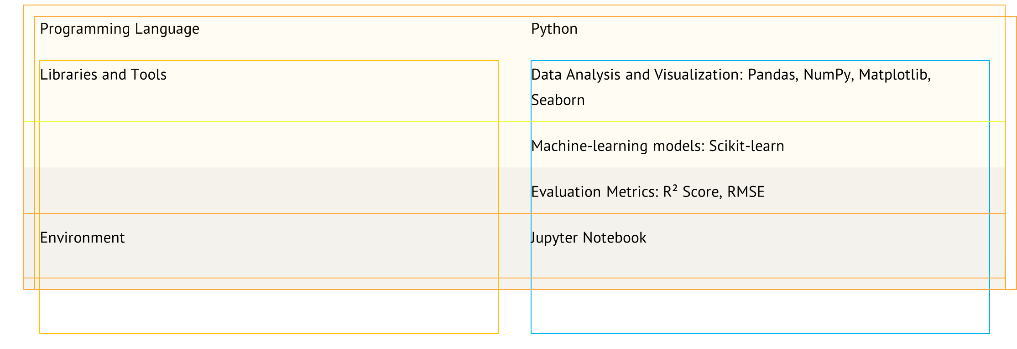
Technology Used

Slide 9

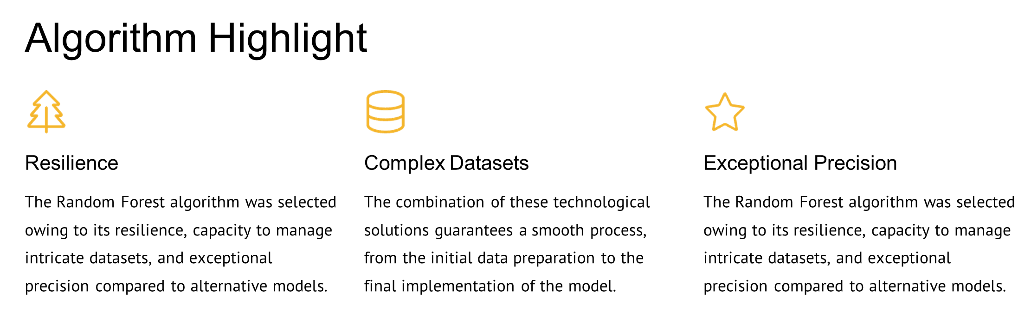
Modelling & Results

Slide 10
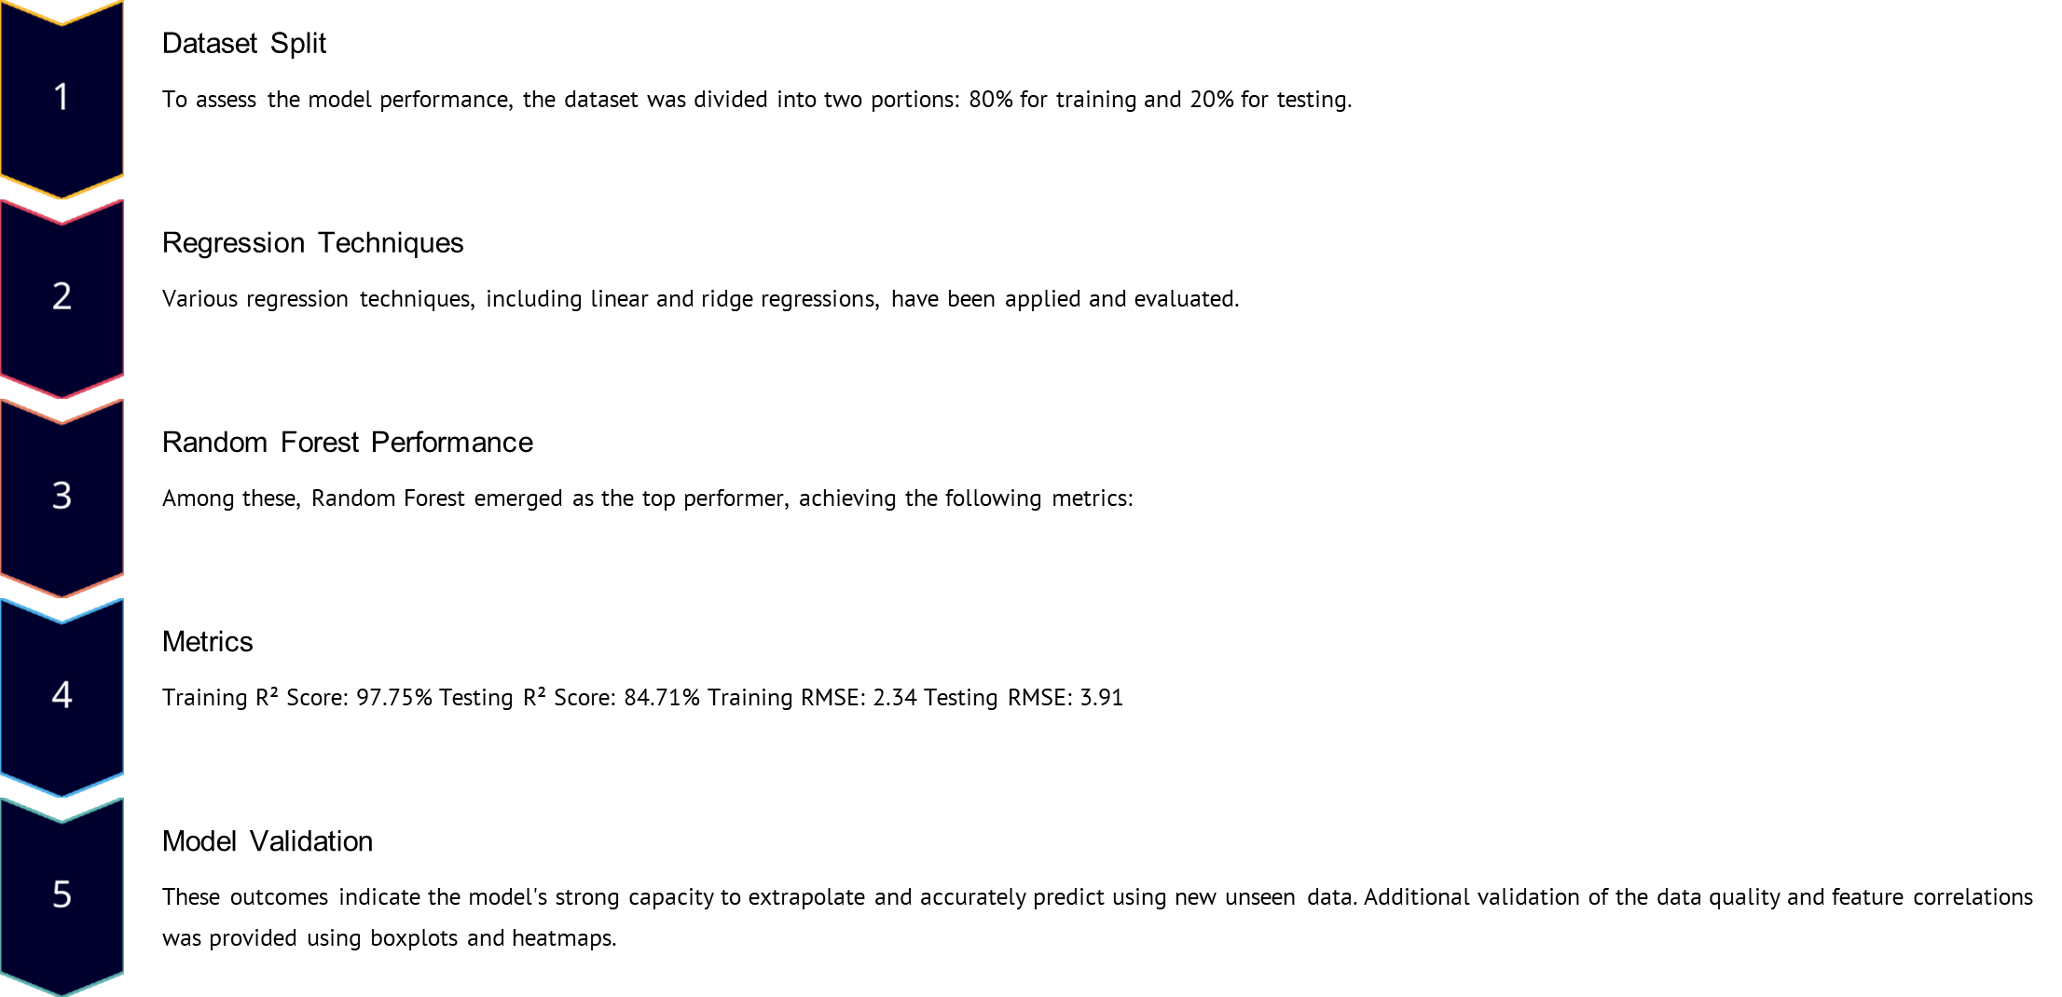
Modelling & Results

Slide 11
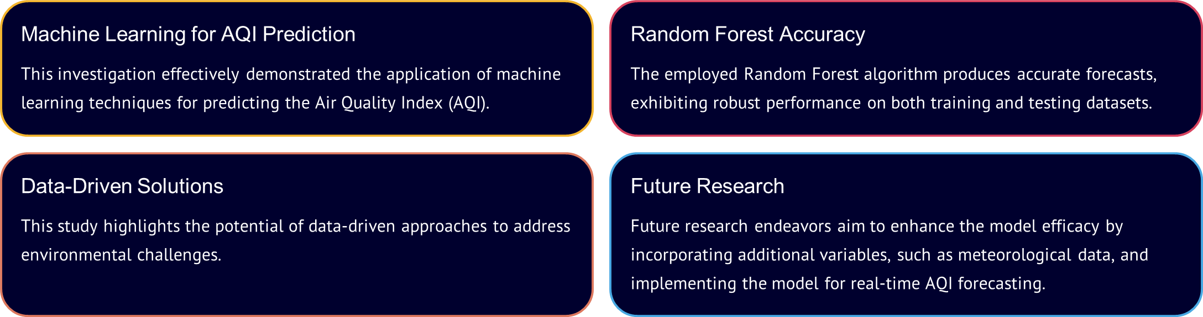
Conclusion

Slide 12

Future Work
1. Weather Data Integration: Boost model accuracy and resilience include meteorological factors, such as temperature, humidity, and wind velocity.
2. Live data streaming: Implementation of IoT air-quality sensors to enable real-time AQI monitoring and instant alerts.
3. Advanced algorithm exploration: Enhances prediction performance by employing sophisticated techniques such as Gradient Boosting or XGBoost.
4. User-Centric Interface Development: Design an interactive web application using StreamLit, a Python library, to offer users easy access to real-time AQI information, historical data visualization, and valuable insights through an intuitive platform.

Slide 13
Thank You!
Notes:
Thank You !!

